Slide 1
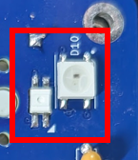




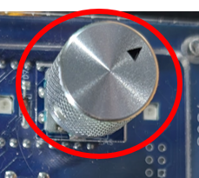
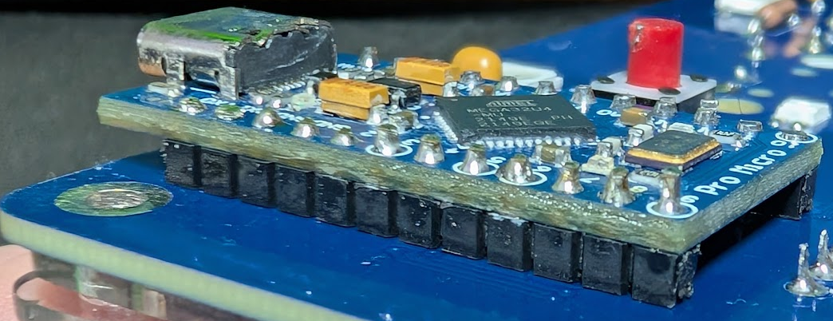
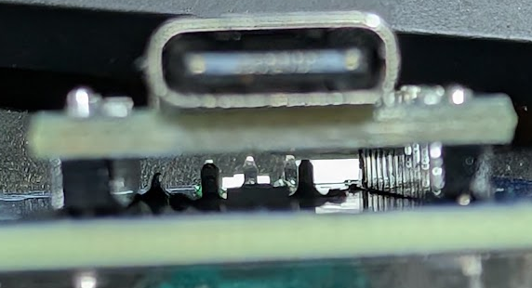
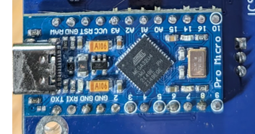
Build Order Page 1
Qty 12: SMT LEDs on back of PCB
R1 through hole resistor (back)
Qty 4: through hole capacitors (back)
Qty 1: push button switch (back)
----- See Paul to check that LEDs are all working -----
5. Qty 7: through hole diodes (front)
6. Qty 1: through hole encoder (front)
----- Carefully verify that encoder is soldered -----
7. Qty 1: through hole microcontroller.
Place header pins (long side through PCB) into PCB and put Pro Micro on top.
Before soldering the header pins, clip the encoder pins if they are close to the PCB.
Solder pins in place on PCB and main PCB.
----- Power up and verify that LEDs all light up -----

Slide 2
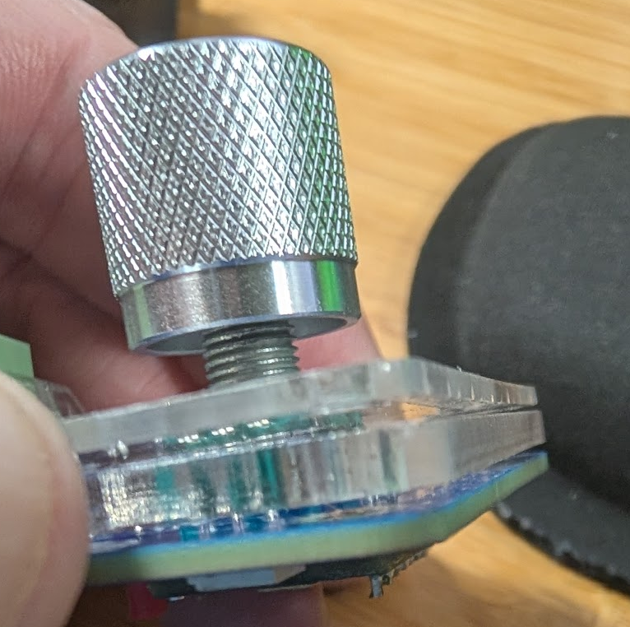
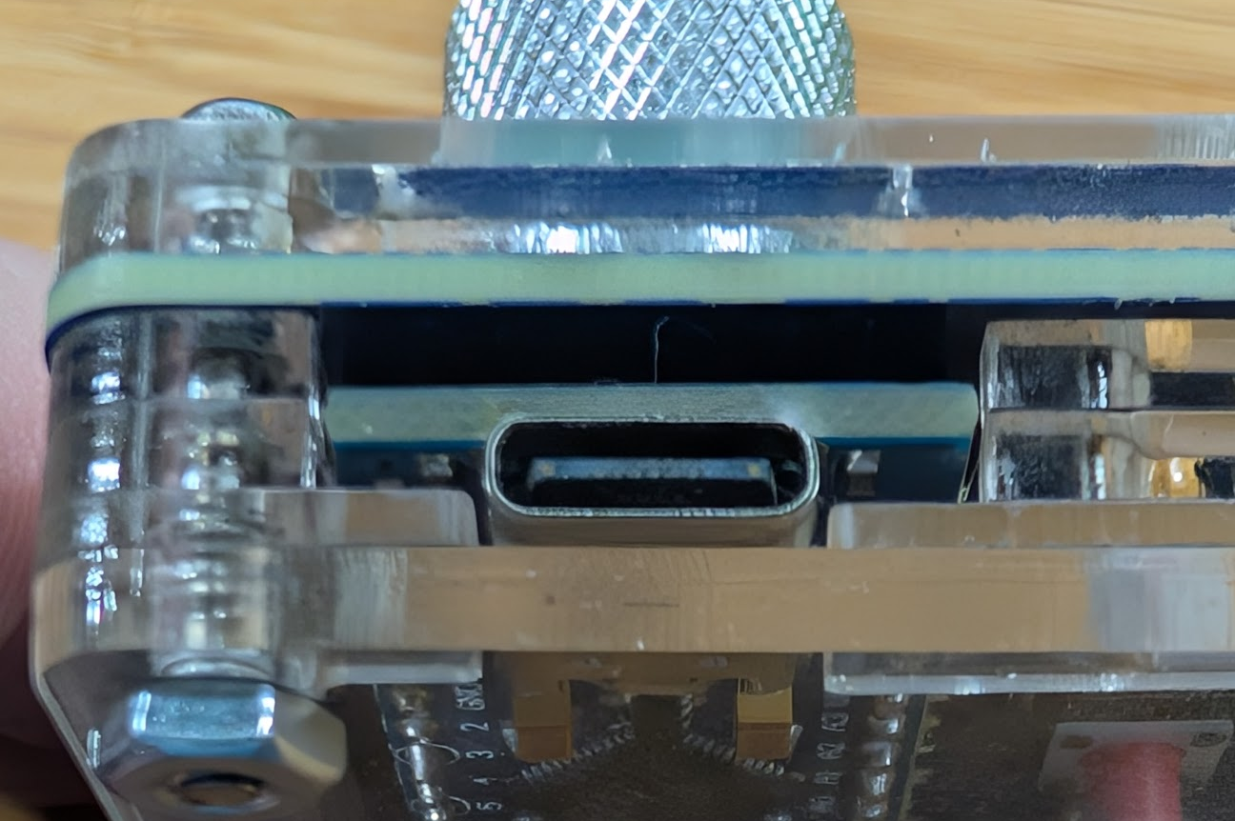
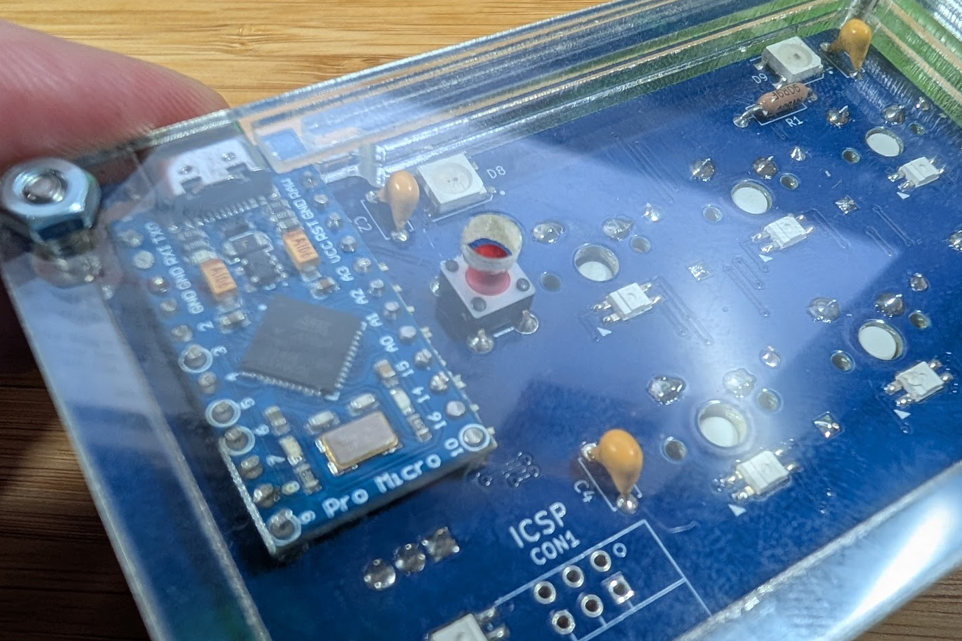
Build Order Page 2
Place acrylic 1/8” thick ring on PCB, Press switches into switch place, paying attention to orientation of pins to PCB holes and orientation of hole over encoder knob base.
Solder switches in place. The acrylic pieces should be flush against the PCB and to each other
----- Power up, see Paul to verify functionality -----
Assemble the rest of the acrylic pieces to complete the enclosure
Add key caps, encoder knob, and rubber feet
Plate/ring are being spread apart in this photo for illustrative purposes
Note the width of the openings around the USB port
The two top rings are identical
The third ring down has a smaller opening
Note the hole provides access to the push button

Slide 3
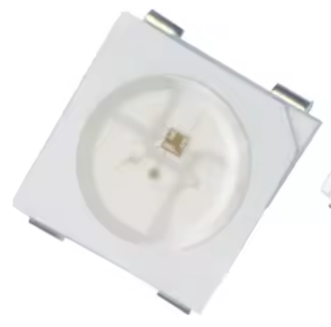
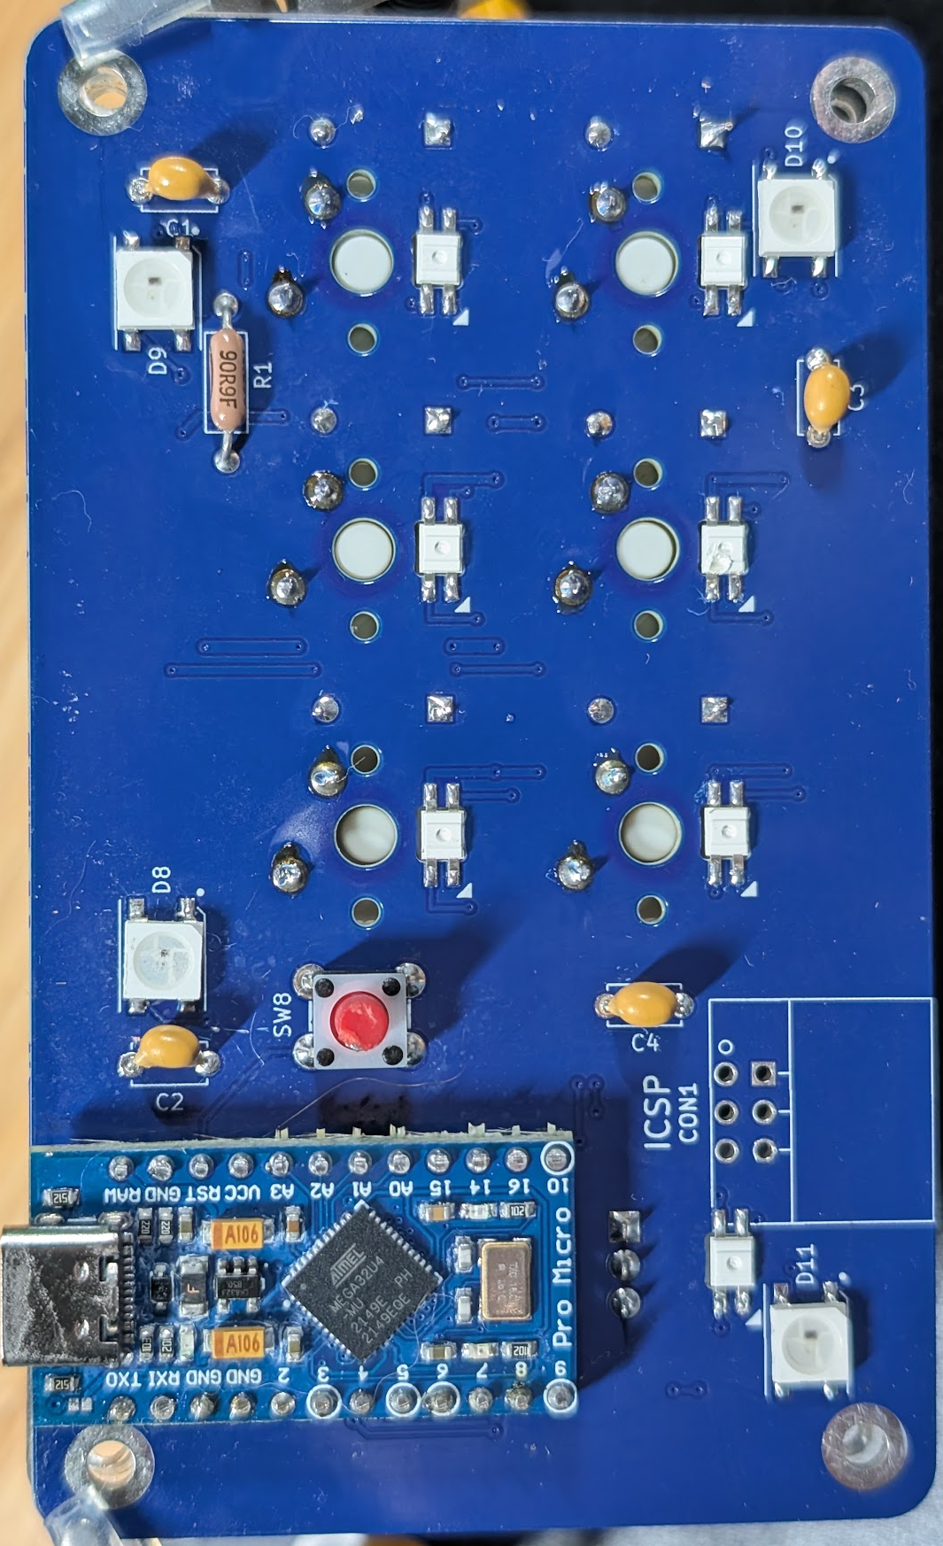
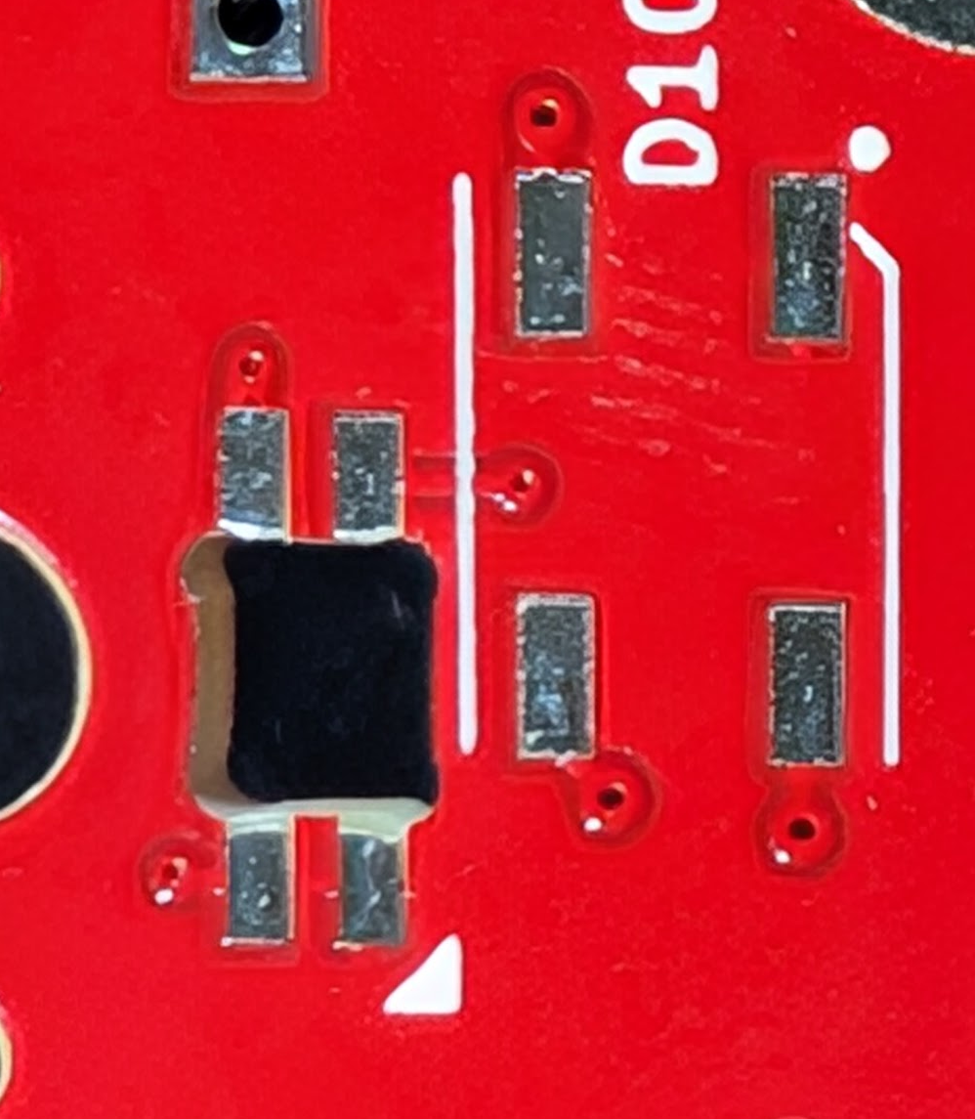
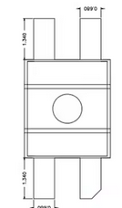
Any Orientation
Orientation
Matters!

Slide 4
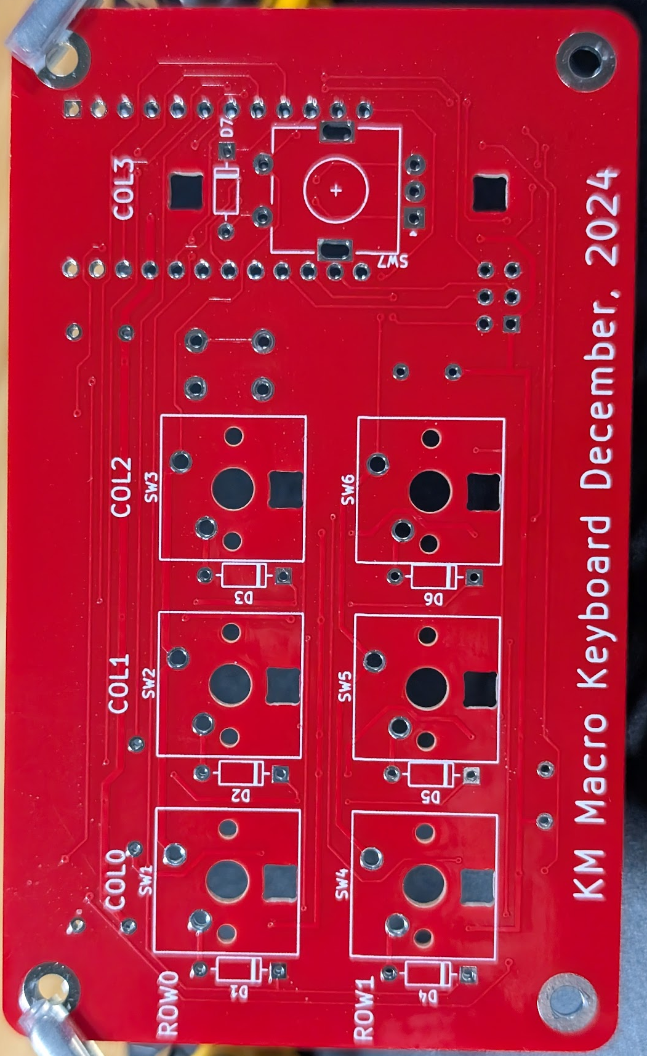
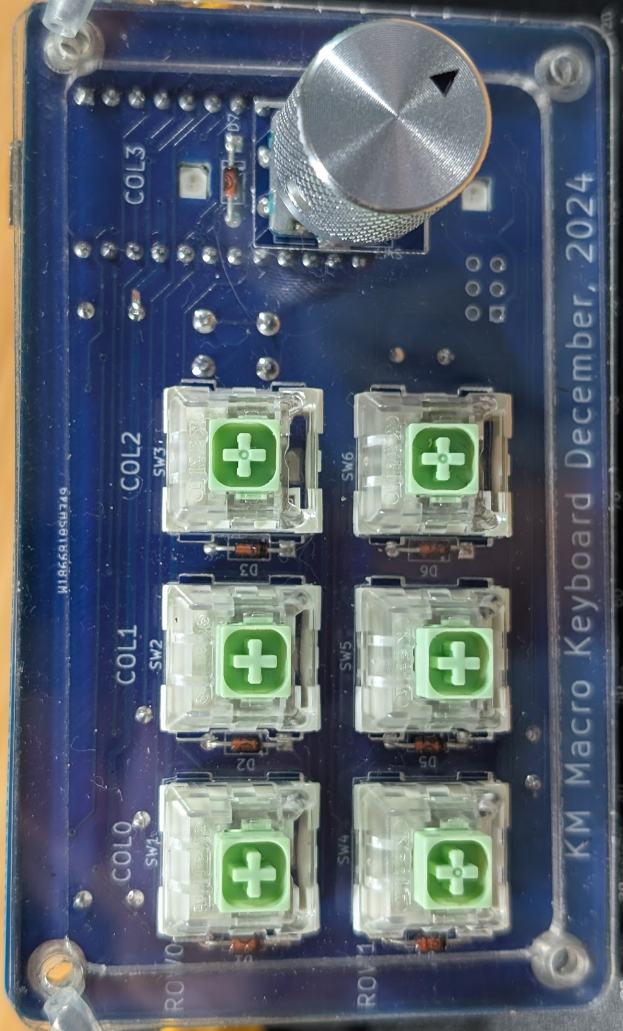
Orientation
Matters!

